Slide 1
Unit 4

Slide 2
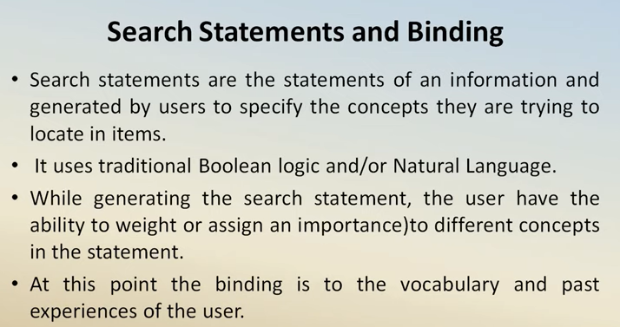

Slide 3
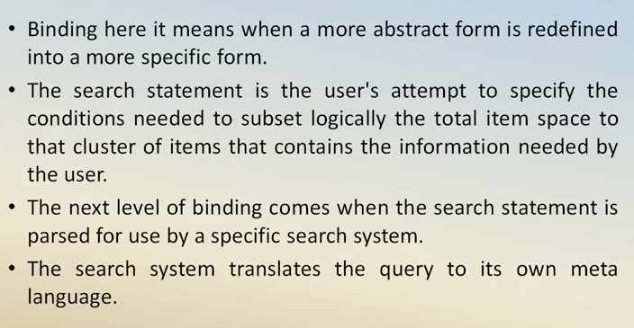

Slide 4
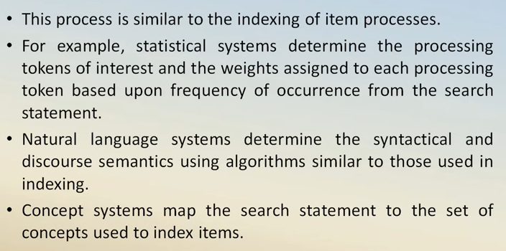

Slide 5
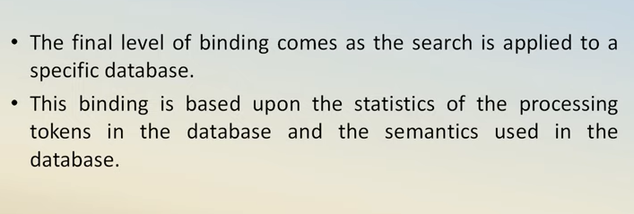

Slide 6
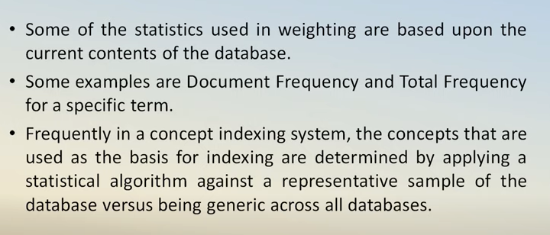

Slide 7
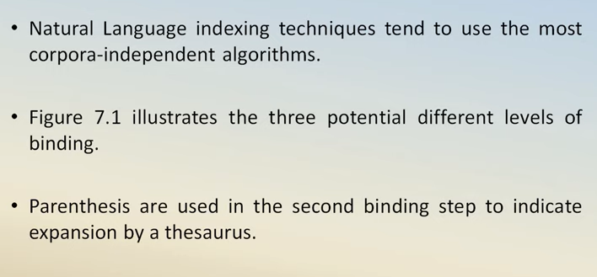

Slide 8
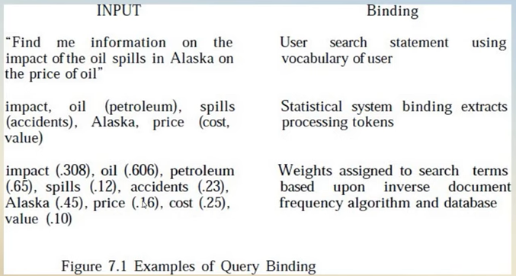

Slide 9
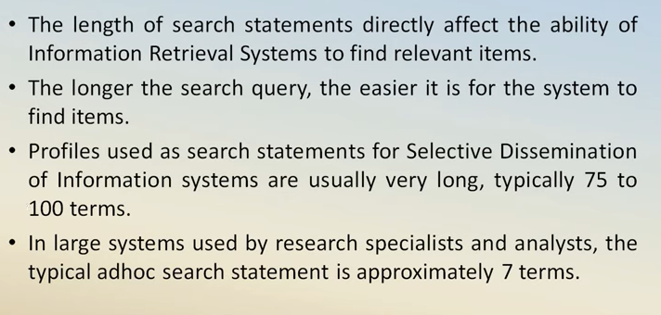

Slide 10
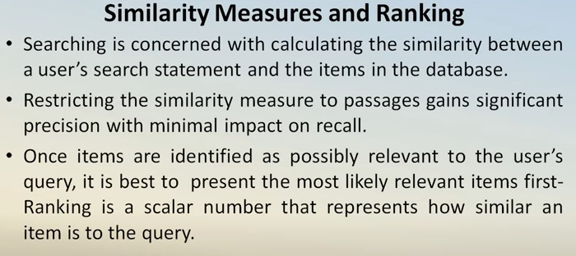

Slide 11
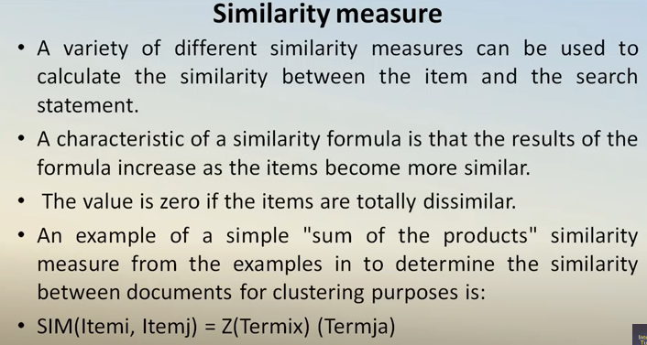

Slide 12
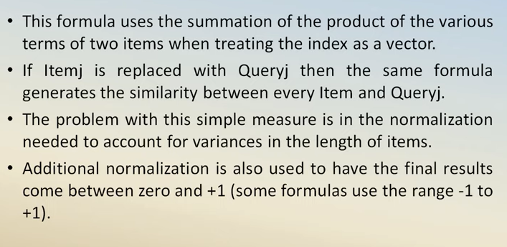

Slide 13
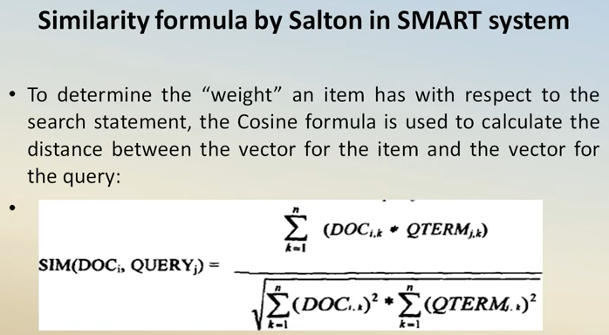

Slide 14
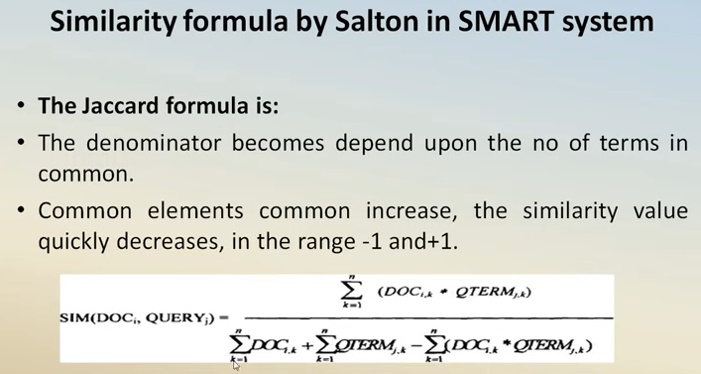

Slide 15
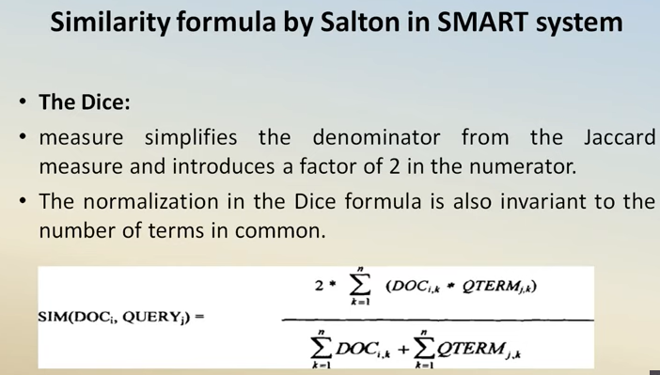

Slide 16
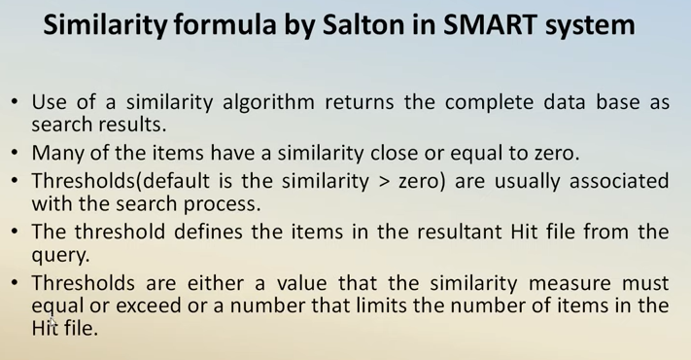

Slide 17
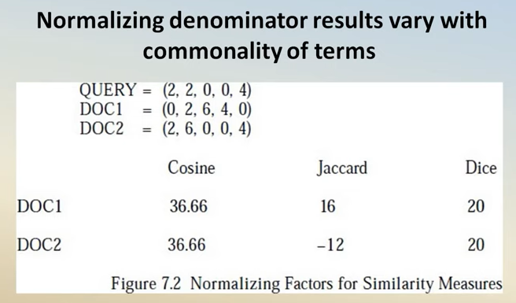

Slide 18
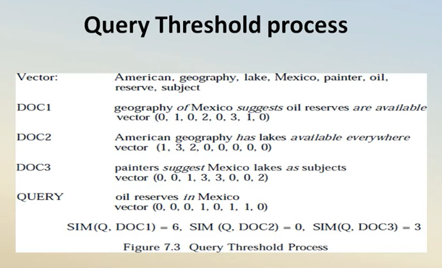

Slide 19
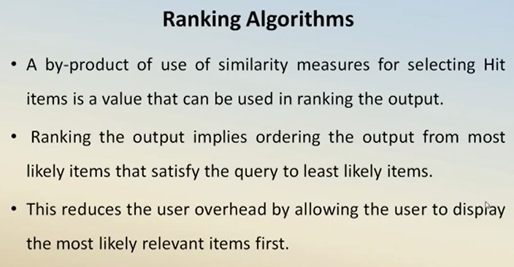

Slide 20
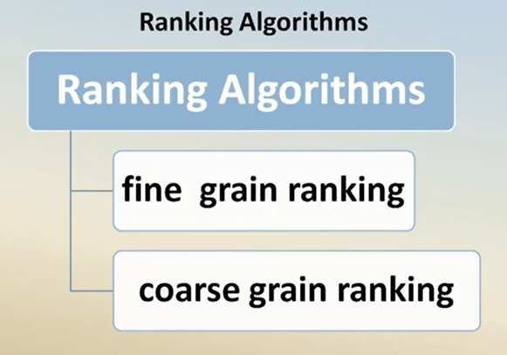

Slide 21
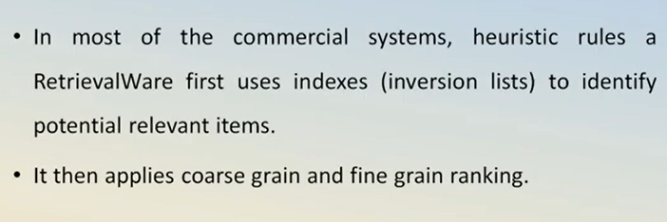

Slide 22
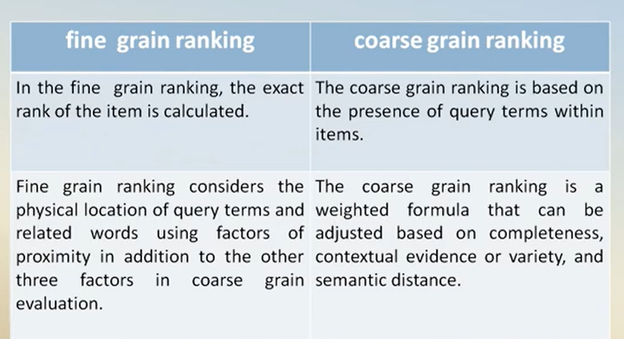

Slide 23
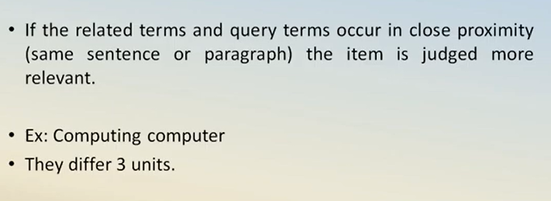

Slide 24
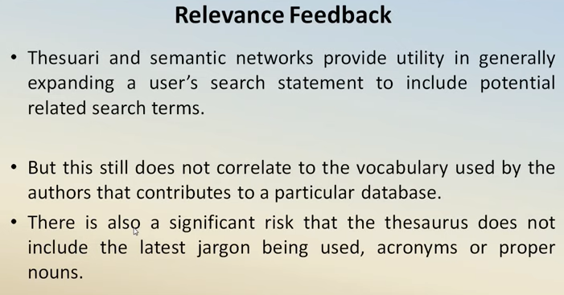

Slide 25
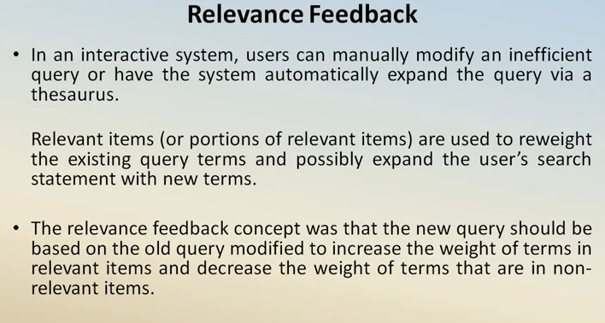

Slide 26
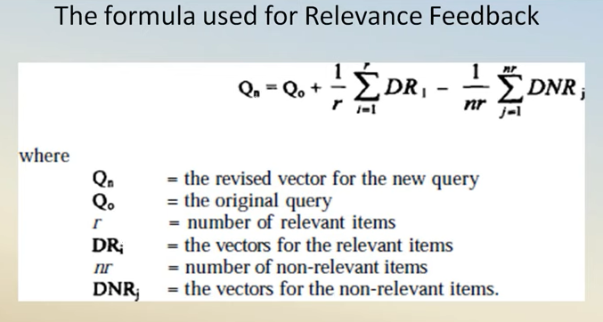

Slide 27
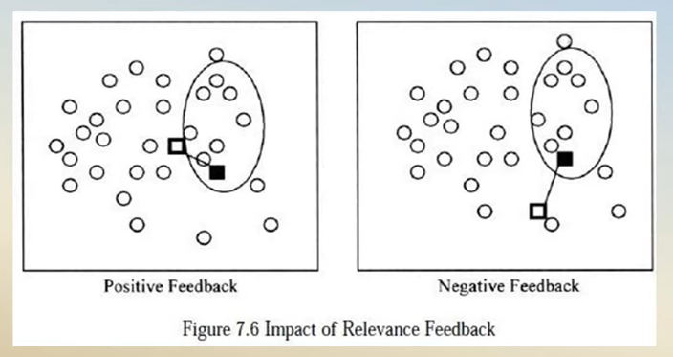

Slide 28
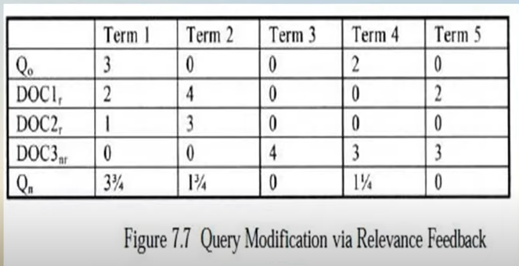

Slide 29
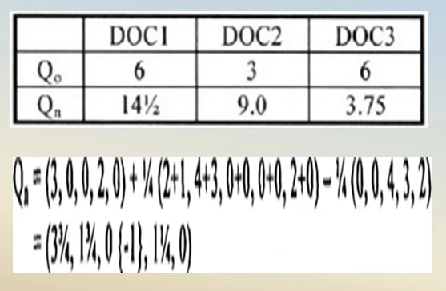

Slide 30
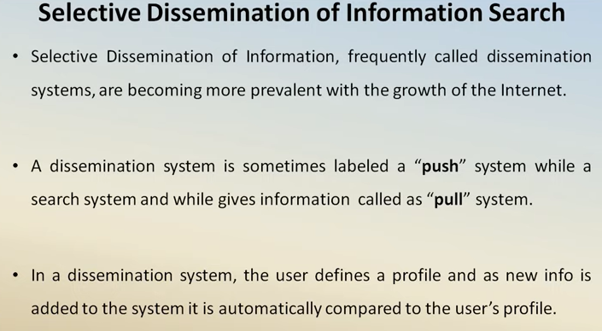

Slide 31
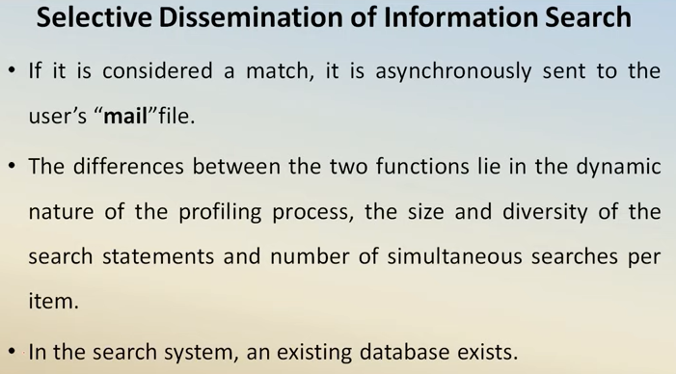

Slide 32
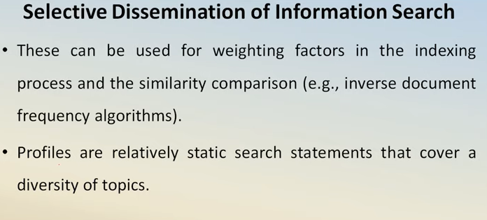

Slide 33
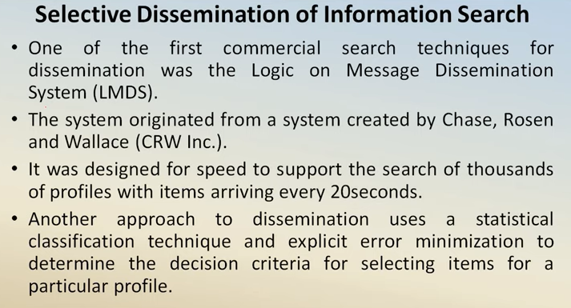

Slide 34
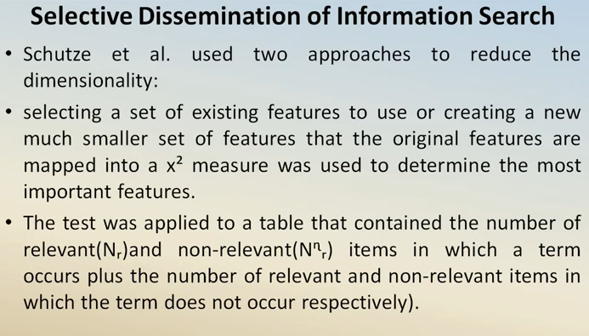

Slide 35
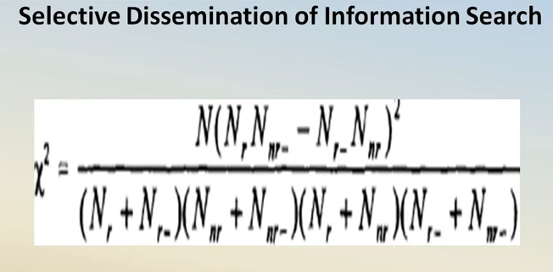

Slide 36
Weighted Searches of Boolean Systems
The two major approaches to generating queries are Boolean and natural language
Natural language queries are easily represented within statistical models and are usable by the similarity measures discussed
Issues arise when Boolean queries are associated with weighted index systems
Some of the issues are associated with how the logic (AND, OR, NOT) operators function with weighted values and how weights are associated with the query terms

Slide 37
Searching the INTERNET and Hypertext
The Internet has multiple different mechanisms that are the basis for search of items
The primary techniques are associated with servers on the Internet that create indexes of items on the Internet and allow search of them
Some of the most commonly used nodes are YAHOO, AltaVista and Lycos
In all of these systems there are active processes that visit a large number of Internet sites and retrieve textual data which they index
Intelligent Agents provide the capability for a user to specify an information need which will be used by the Intelligent Agent as it independently moves between Internet sites locating information of interest

Slide 38
There are six key characteristics of intelligent agents
Autonomy
Communications Ability
Capacity for Cooperation
Capacity for Reasoning
Adaptive Behaviour
Trustworthiness

Slide 39
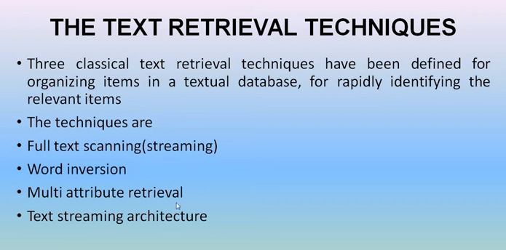

Slide 40
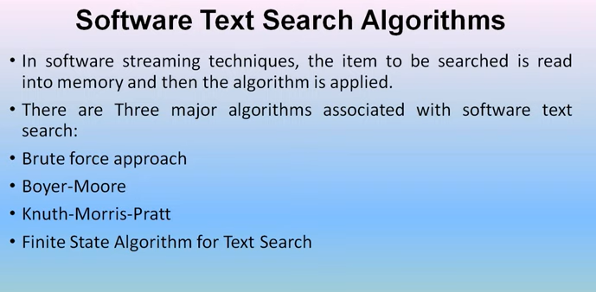

Slide 41
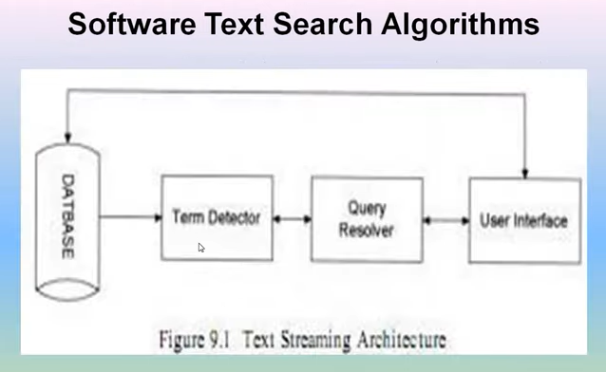

Slide 42
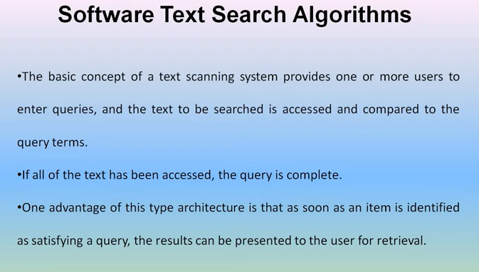

Slide 43
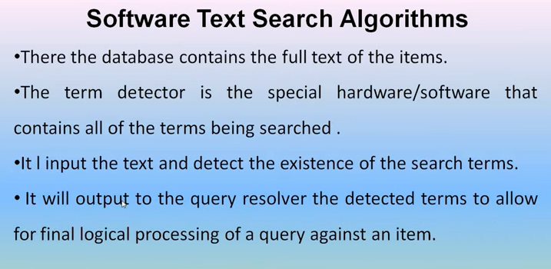

Slide 44
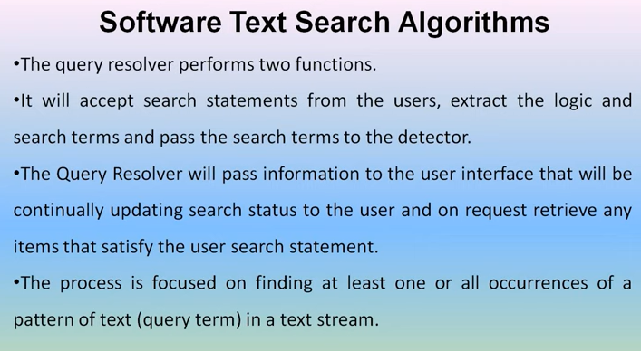

Slide 45
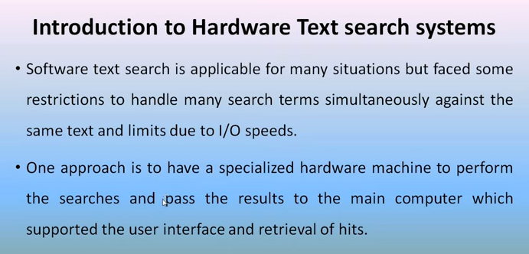

Slide 46
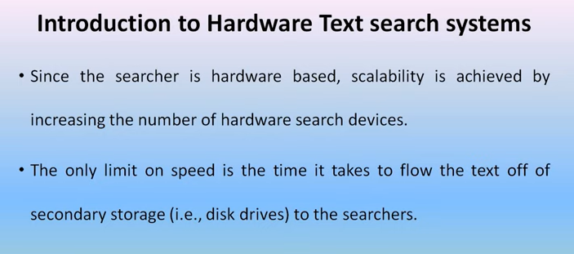

Slide 47
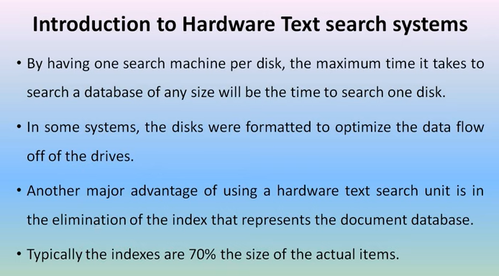

Slide 48
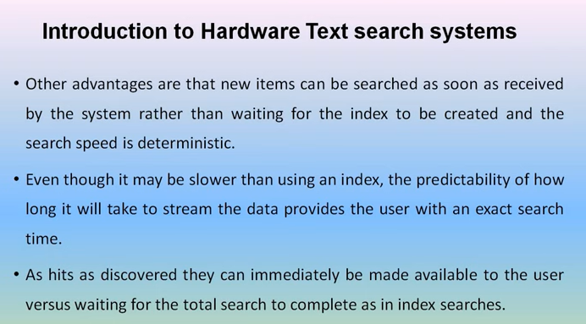

Slide 49
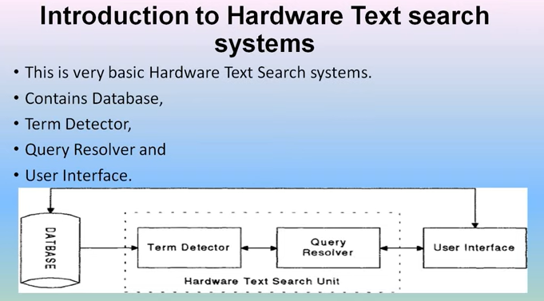

Slide 50
